Slide 1
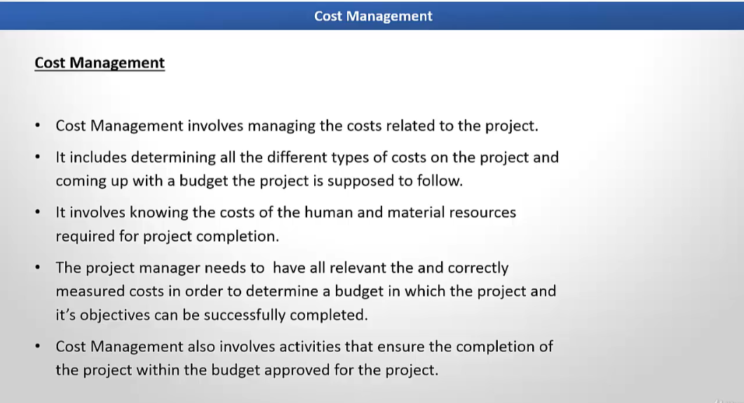

Slide 2
Project Cost
Definition: Project cost management involves planning, estimating, budgeting, financing, funding, managing, and controlling costs to complete a project within the approved budget.
Components:
Direct Costs: Costs directly attributable to the project (e.g., labor, materials).
Indirect Costs: Overhead costs not directly tied to the project (e.g., office rent).
Key Processes:
Estimating costs.
Determining the budget.
Controlling costs.

Slide 3
Example
Estimate Cost: Estimating the cost of materials, labor, and equipment for building a house.
Bricks: $10,000
Cement: $5,000
Labor: $20,000
Determine Budget: Adding the above costs along with contingency reserves and management reserves.
Total Estimated Cost: $35,000
Contingency Reserve: $3,500 (10%)
Management Reserve: $1,500
Total Budget: $40,000

Slide 4
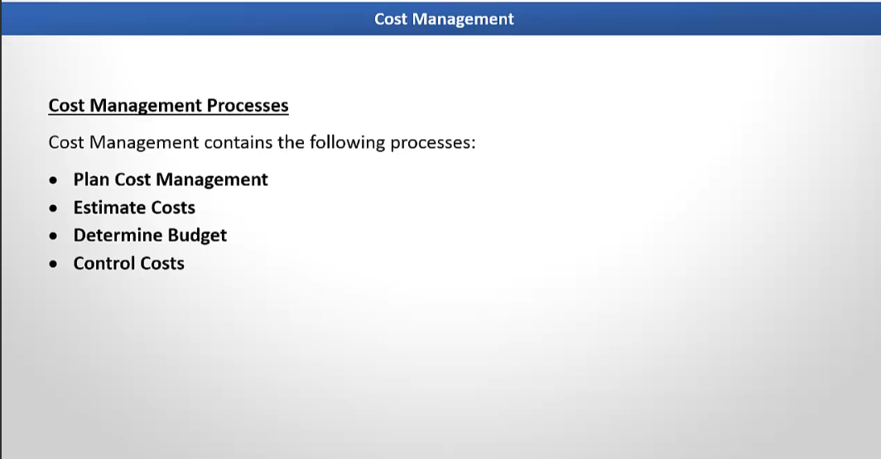

Slide 5
Cost Management Planning
Definition: Establishing policies, procedures, and documentation for managing project costs.
Purpose: Ensures a consistent approach to cost management.
Example: A company decides to use a specific cost estimation template across all projects. For a website development project, the cost management plan includes tools like MS Excel for budget tracking, a defined contingency reserve for risks, and weekly reviews to monitor financial health.

Slide 6
Cost Estimation
Definition: Approximation of the monetary resources needed to complete project activities.
Methods:
Analogous Estimation: Based on costs of similar projects.
Parametric Estimation: Uses statistical relationships.
Bottom-Up Estimation: Aggregating costs for individual activities.
Three-Point Estimation: Uses optimistic, pessimistic, and most likely scenarios.
Example: For a construction project:
Materials cost: $50,000
Labor cost: $40,000
Contingency reserve (5%): $4,500
Total estimated cost: $94,500

Slide 7
Budgeting
Definition: Aggregating estimated costs to establish an authorized cost baseline.
Purpose: Provides a framework to measure project performance.
Components:
Cost Baseline: Approved time-phased project budget.
Management Reserve: Funds for unforeseen risks.
Example: In a mobile app development project:
Development cost: $30,000 (phased over 3 months)
Testing cost: $10,000
Contingency: $5,000
Total project budget: $45,000

Slide 8
Cost Control
Definition: Monitoring project status to update the budget and manage changes to the cost baseline.
Techniques:
Earned Value Management (EVM): Tracks project performance.
Variance Analysis: Identifies deviations.
Forecasting: Predicts future performance.
Example:
Budgeted Cost of Work Scheduled (BCWS): $20,000
Earned Value (EV): $18,000
Actual Cost (AC): $22,000
Cost Performance Index (CPI): EV / AC = $18,000 / $22,000 = 0.82 (indicating cost overrun).

Slide 9
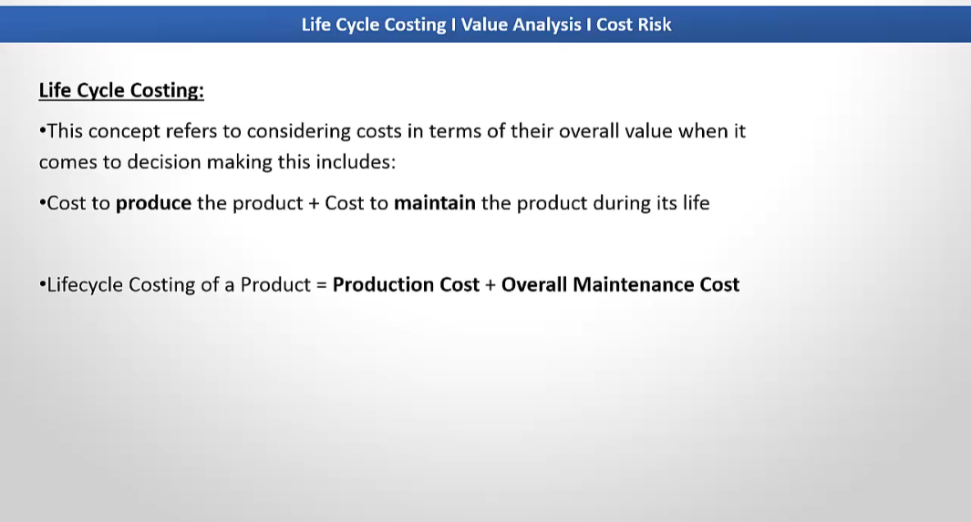

Slide 10
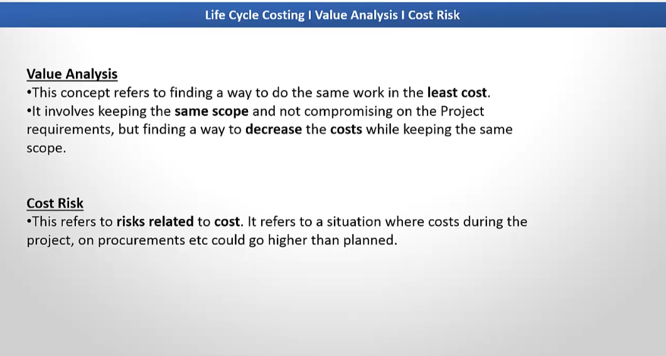

Slide 11
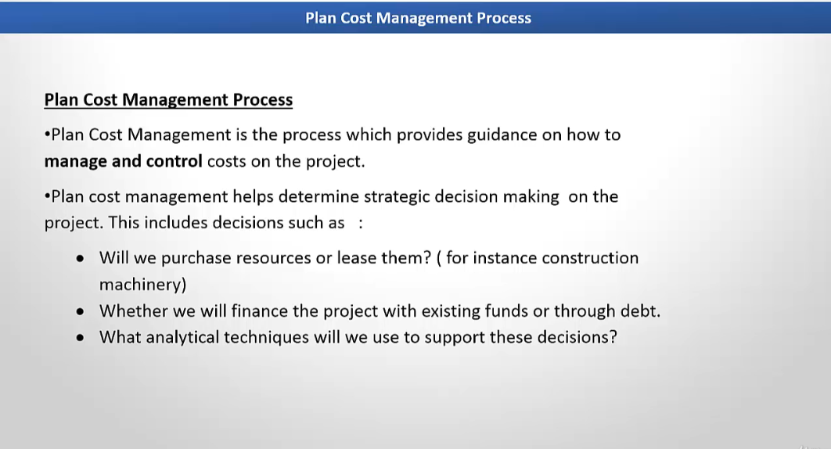

Slide 12
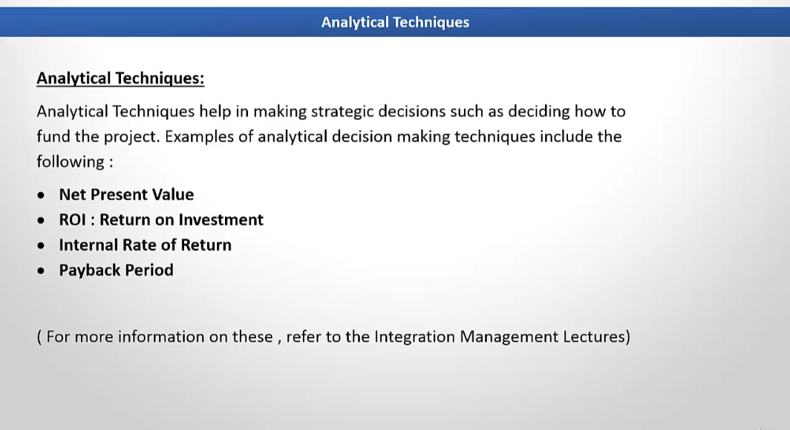

Slide 13
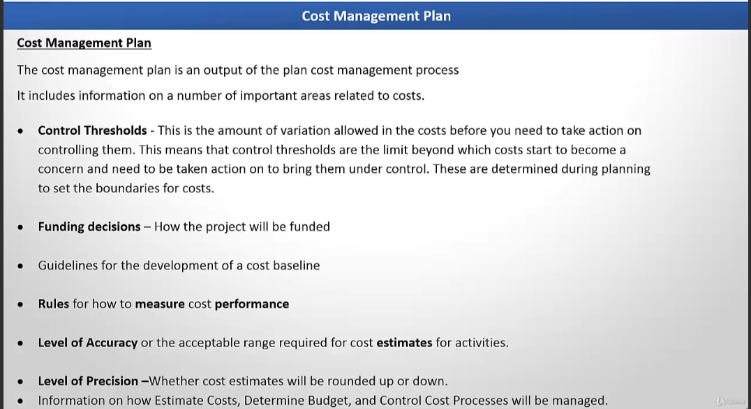

Slide 14
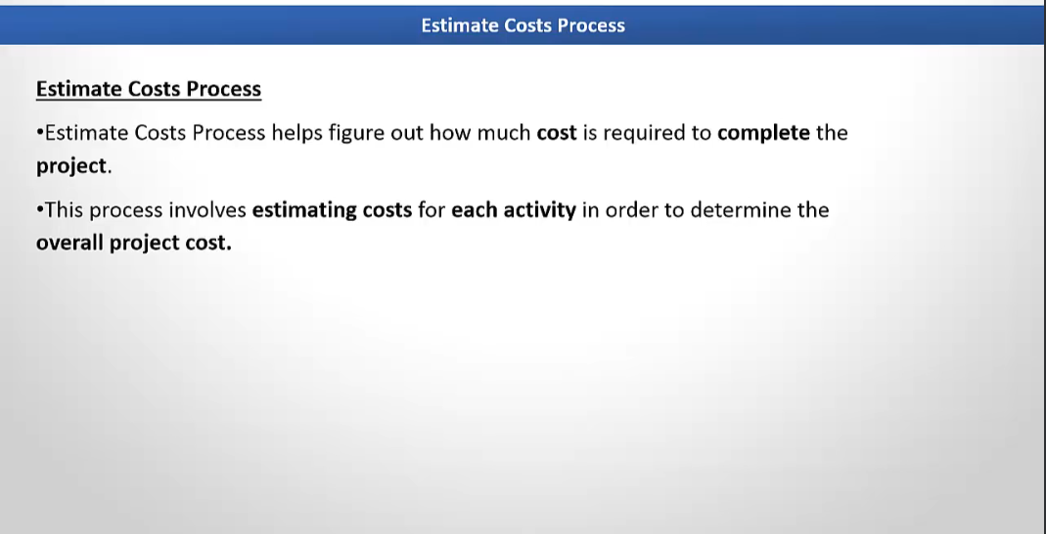

Slide 15
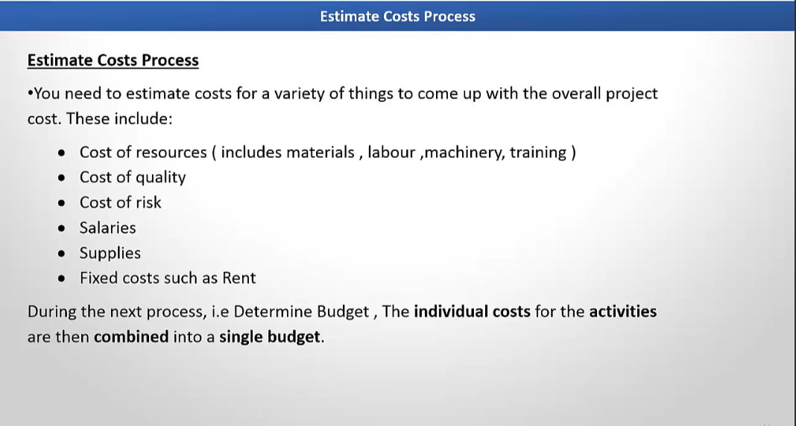

Slide 16
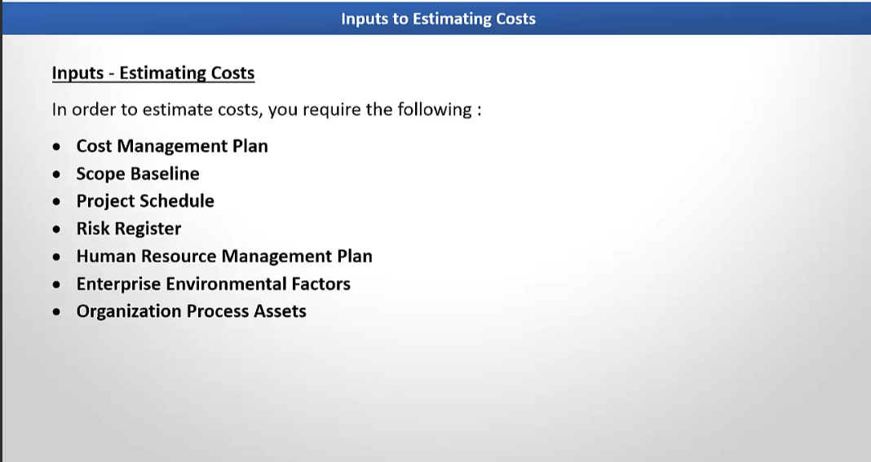

Slide 17
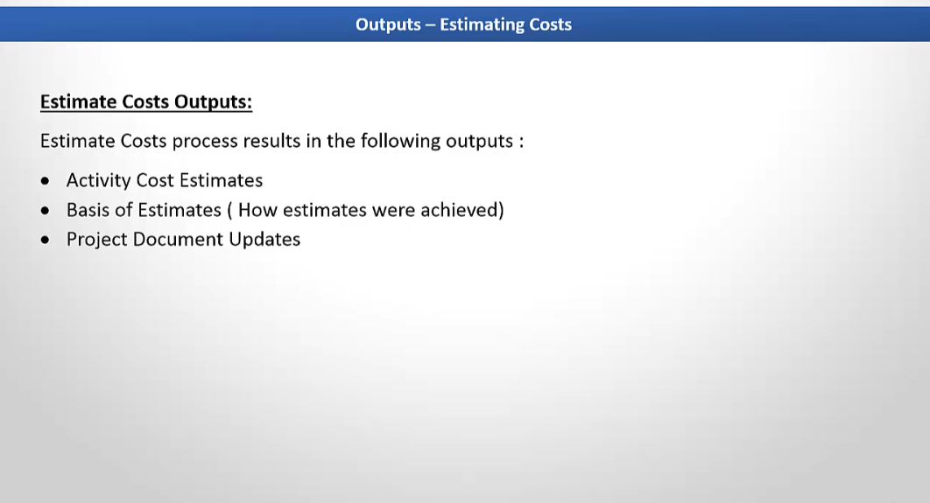

Slide 18
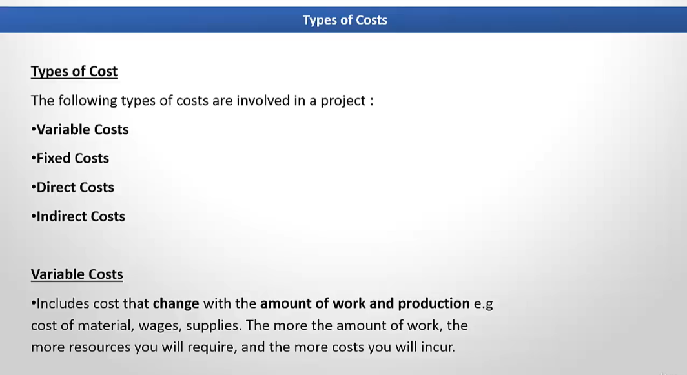

Slide 19
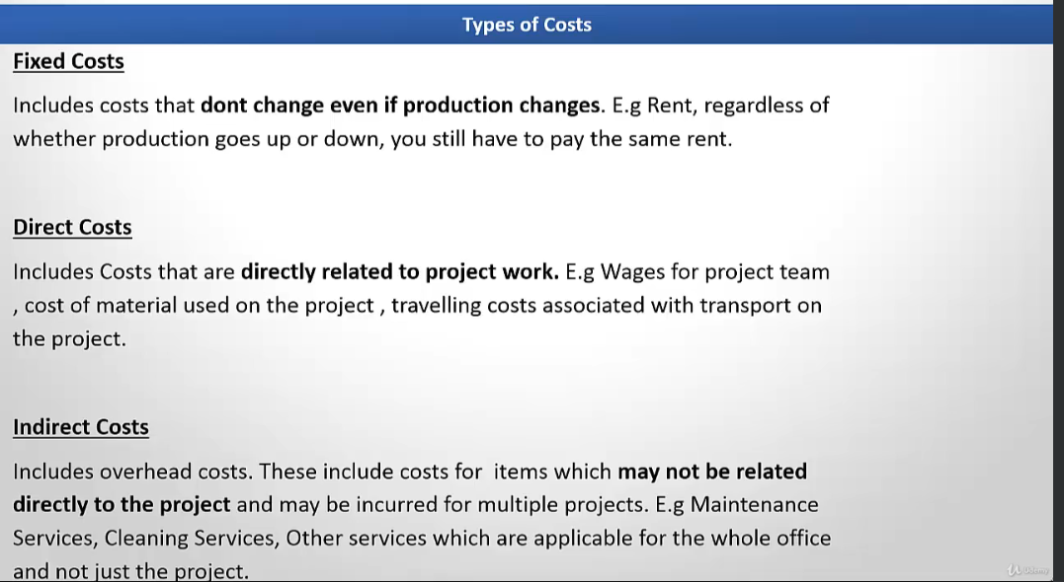

Slide 20
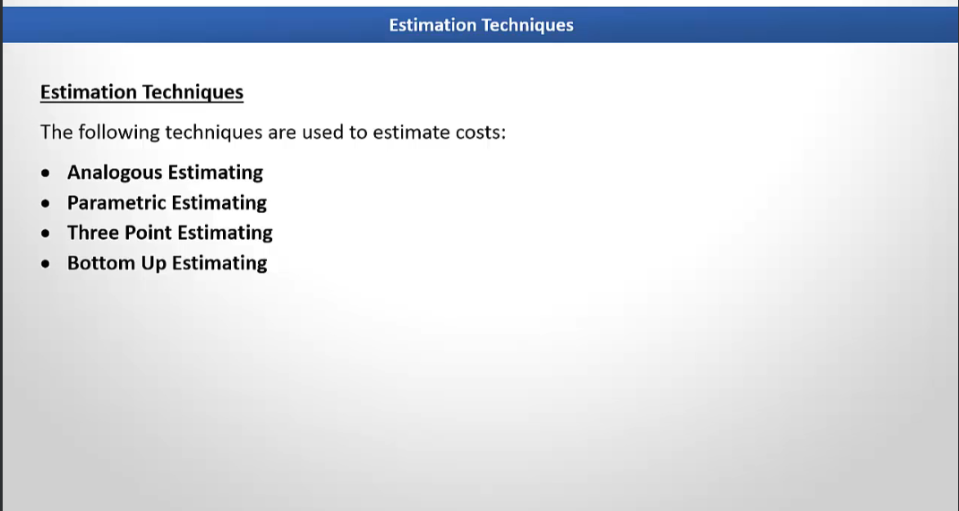

Slide 21
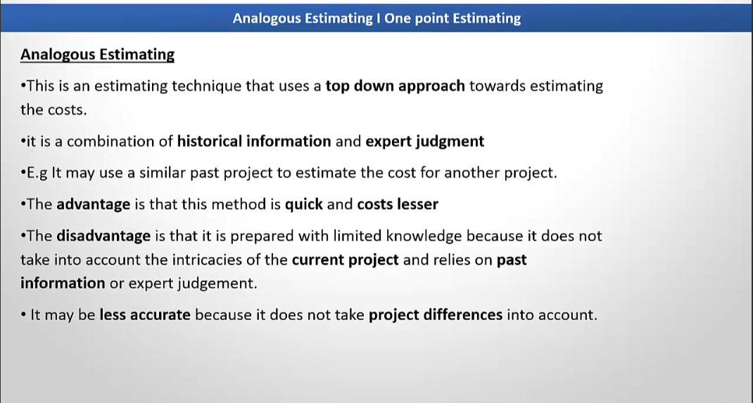

Slide 22
Analogous Estimation
Definition: Uses historical data from similar projects to estimate costs.
Characteristics:
Fast and cost-effective.
Less accurate compared to other methods.
Relies on expert judgment and historical records.
Use Case: Early stages of a project with limited information.
Example: If a similar website development project cost $50,000 and the current project is of comparable scope, the estimated cost would also be $50,000, adjusted for inflation or differences in scope.

Slide 23
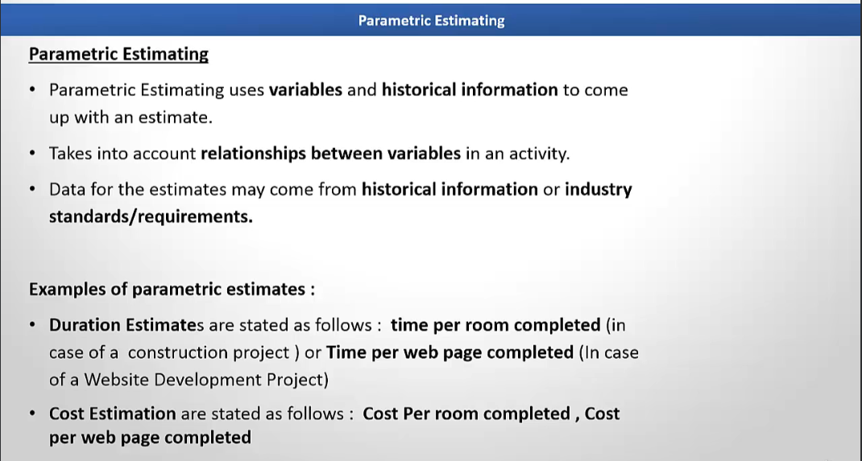

Slide 24
Parametric Estimation
Definition: Uses statistical relationships between historical data and project parameters to estimate costs.
Characteristics:
Based on measurable units (e.g., cost per square foot, cost per item).
More accurate if the relationship is well-defined.
Use Case: Projects with repetitive tasks and available data.
Example: In a software development project, if the average cost to develop a single feature is $2,000 and the project requires 25 features, the total estimated cost is: Total Cost=25×2,000=50,000\text{Total Cost} = 25 \times 2,000 = 50,000Total Cost=25×2,000=50,000

Slide 25
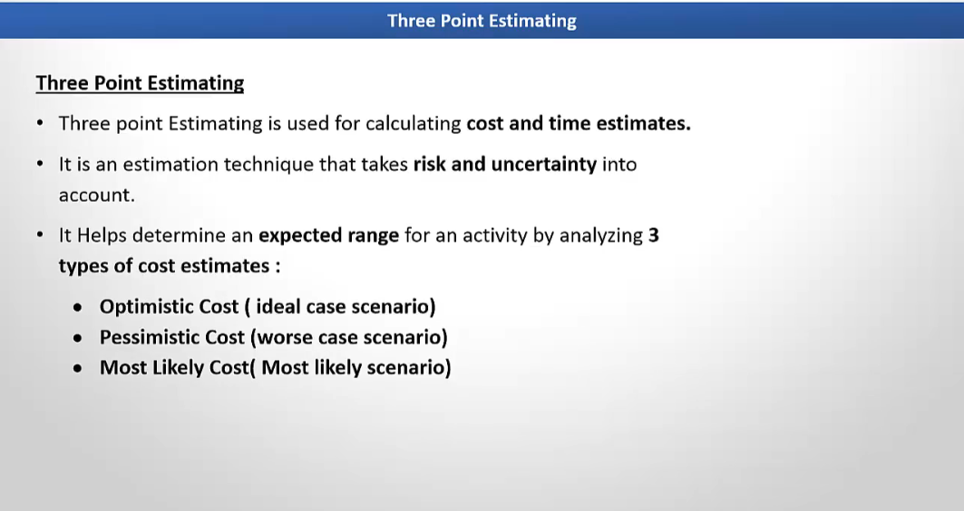

Slide 26
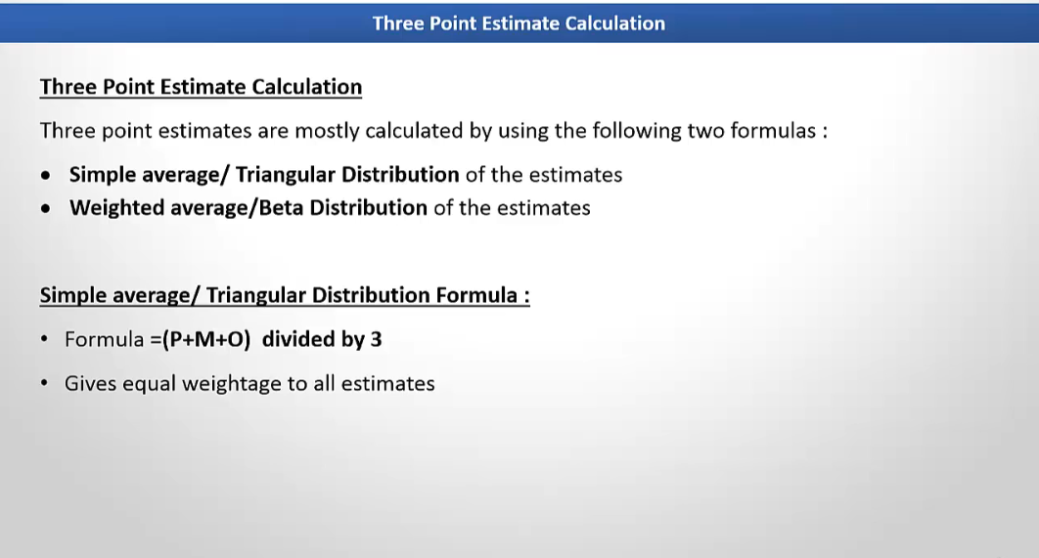

Slide 27
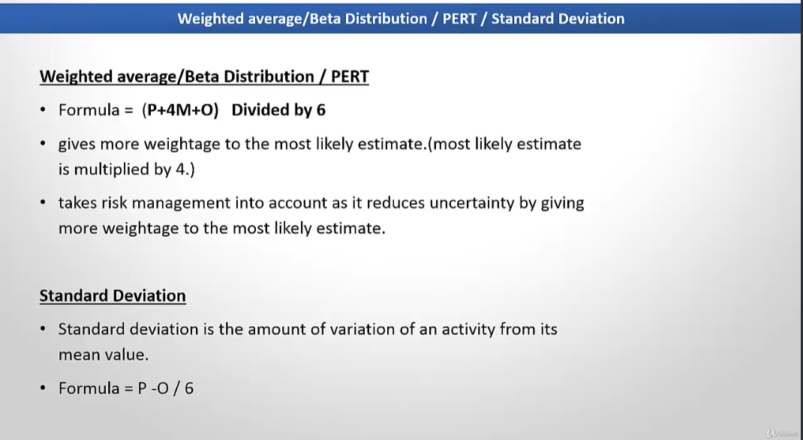

Slide 28
Three-Point Estimation
Definition: Considers uncertainty by using three scenarios—Optimistic, Pessimistic, and Most Likely—to calculate an average estimate.
Formula:
PERT Formula
Use Case: When there’s uncertainty in estimates.
Example: A construction project estimates the following for material costs:
Optimistic: $40,000
Most Likely: $50,000
Pessimistic: $70,000 Using PERT:
Estimate=40,000+4×50,000+70,0006=53,333\text{Estimate} = \frac{40,000 + 4 \times 50,000 + 70,000}{6} = 53,333Estimate=640,000+4×50,000+70,000​=53,333

Slide 29
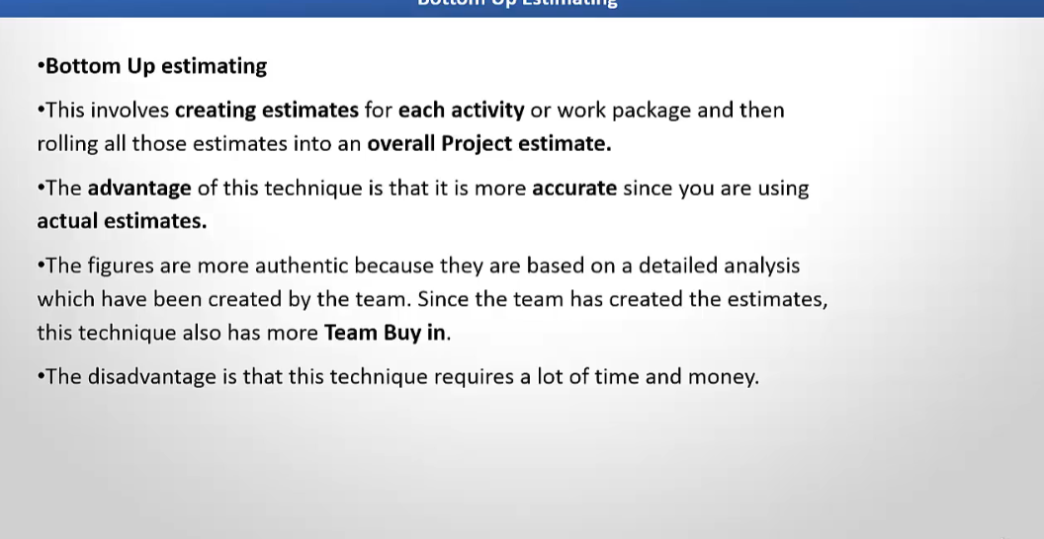

Slide 30
Bottom-Up Estimation
Definition: Breaks the project into smaller components, estimates each part, and aggregates them for the total cost.
Characteristics:
Highly detailed and accurate.
Time-consuming and resource-intensive.
Use Case: Detailed project planning with a well-defined scope.
Example: For a mobile app development project, costs are estimated as follows:
UI/UX Design: $15,000
Backend Development: $25,000
Testing: $10,000
Deployment: $5,000 Total Estimated Cost:
15,000+25,000+10,000+5,000=55,00015,000 + 25,000 + 10,000 + 5,000 = 55,00015,000+25,000+10,000+5,000=55,000

Slide 31
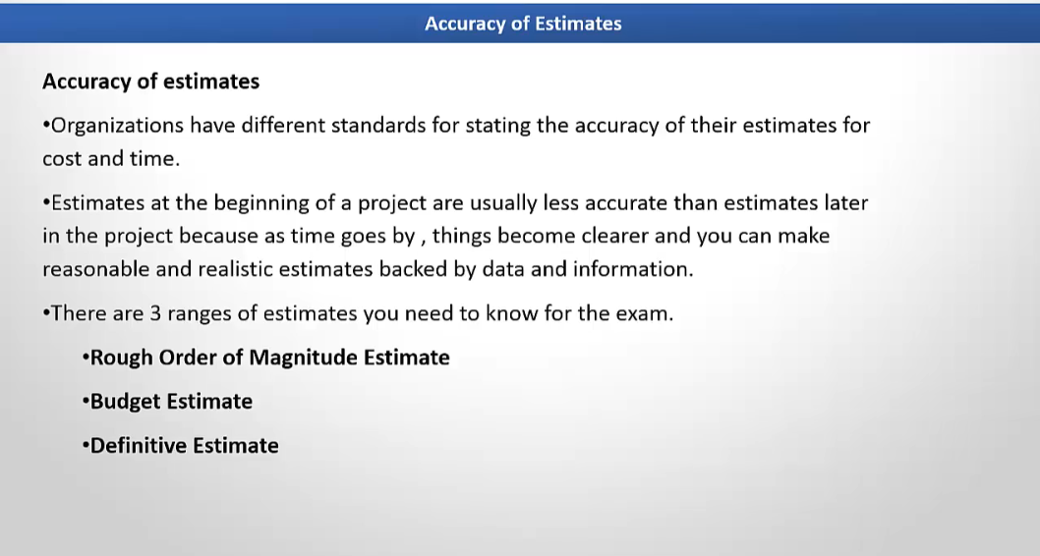

Slide 32
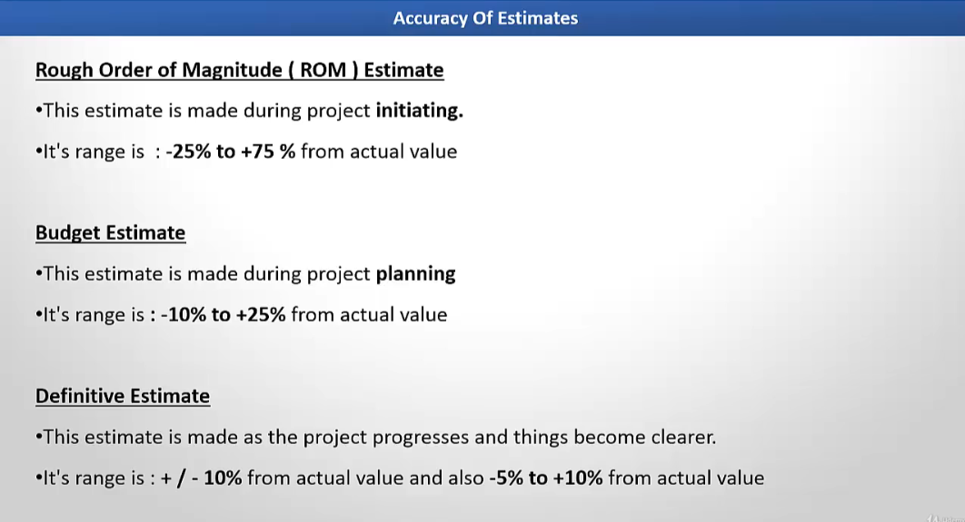

Slide 33
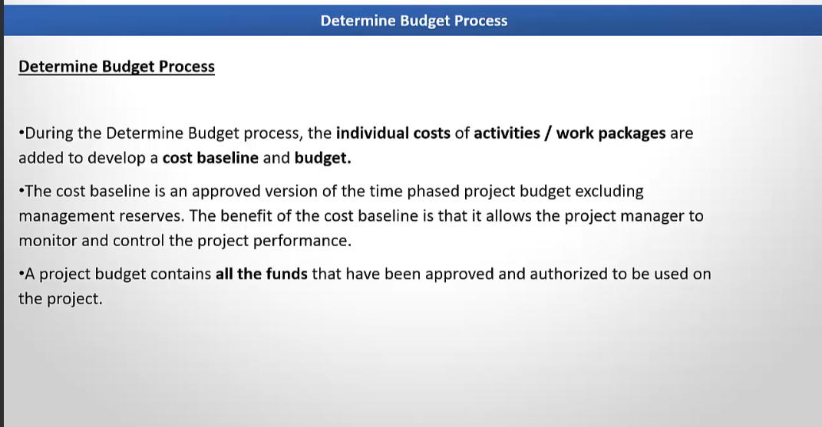

Slide 34
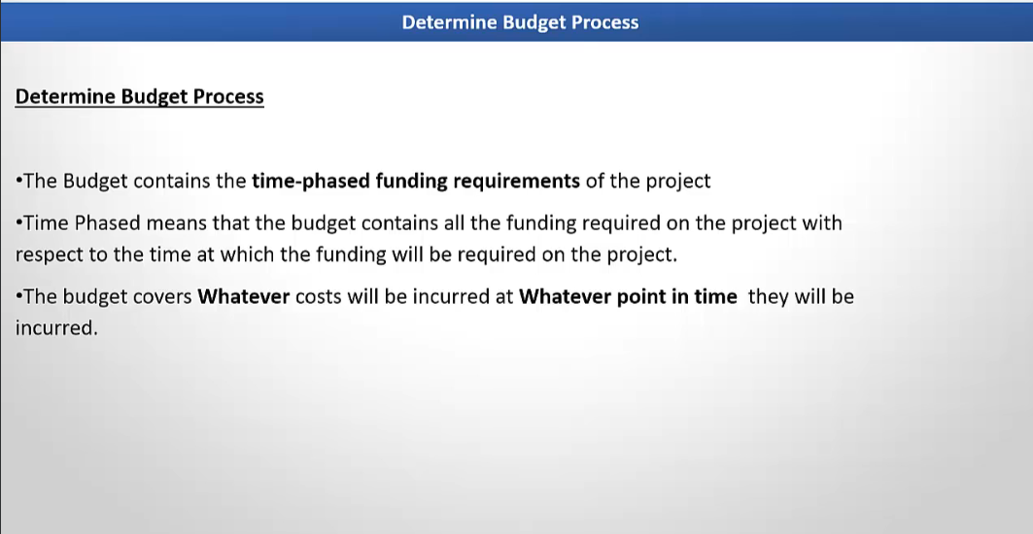

Slide 35
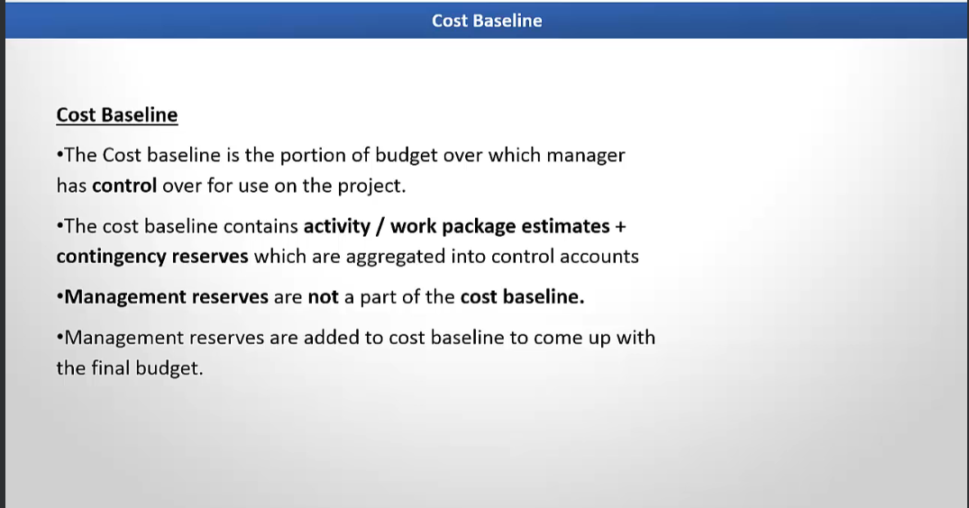

Slide 36
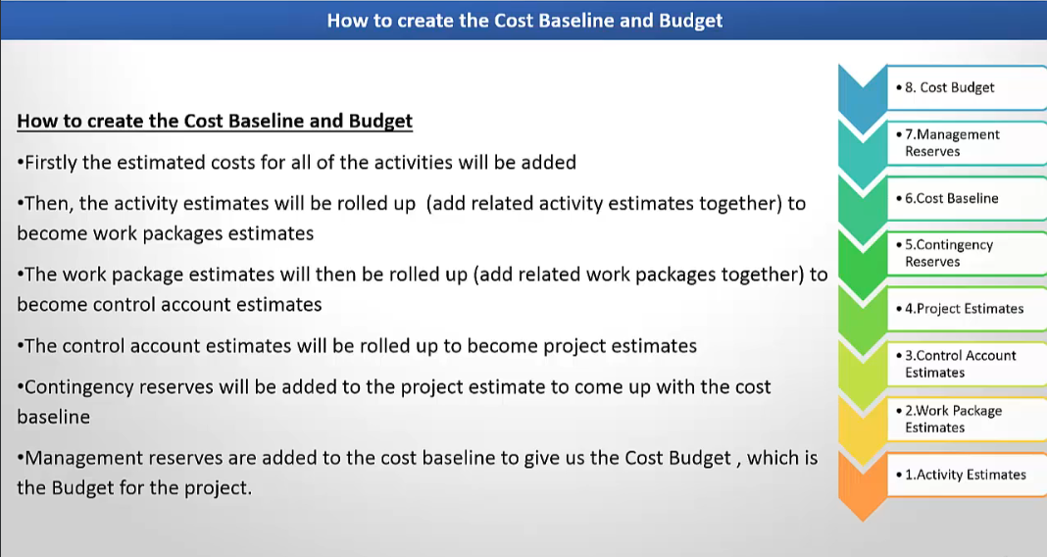

Slide 37
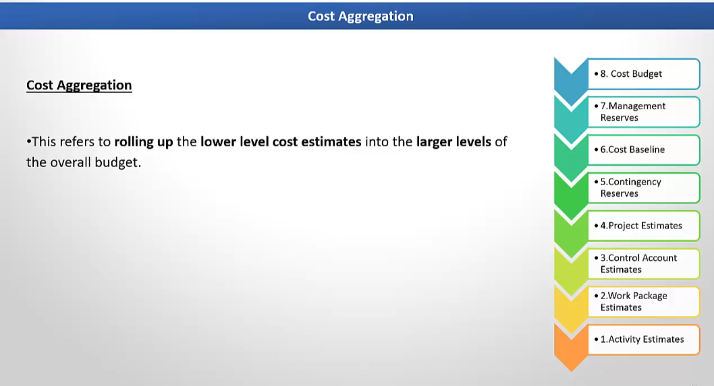

Slide 38
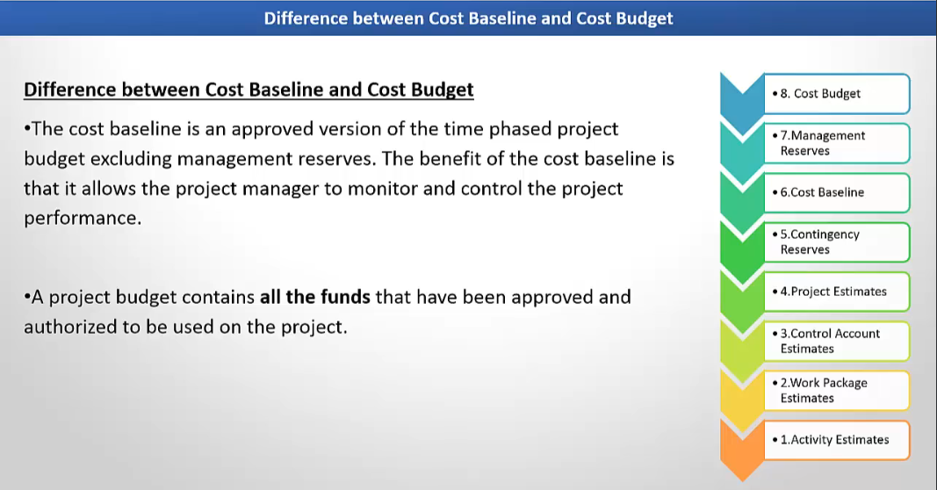

Slide 39
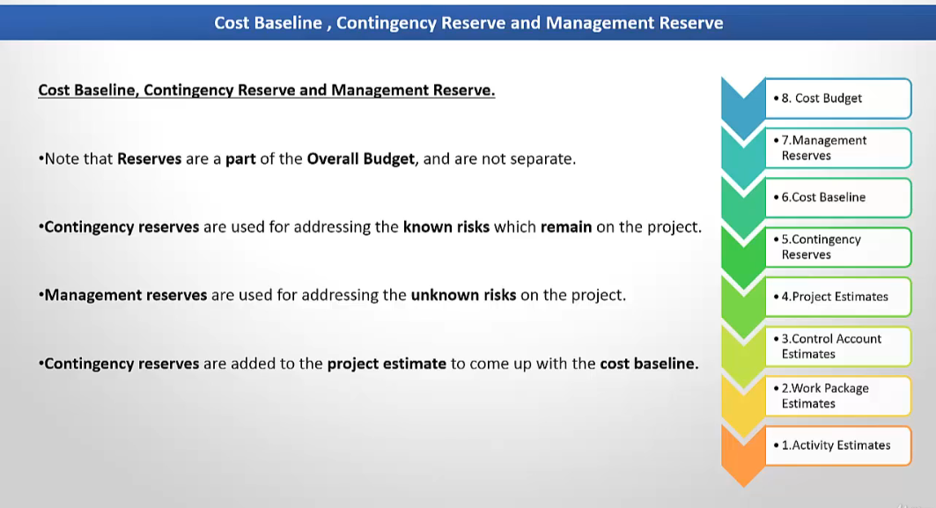

Slide 40
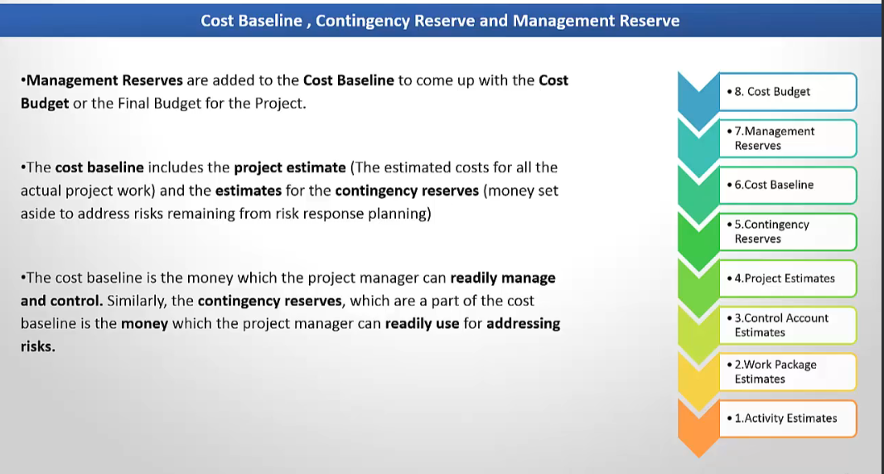

Slide 41
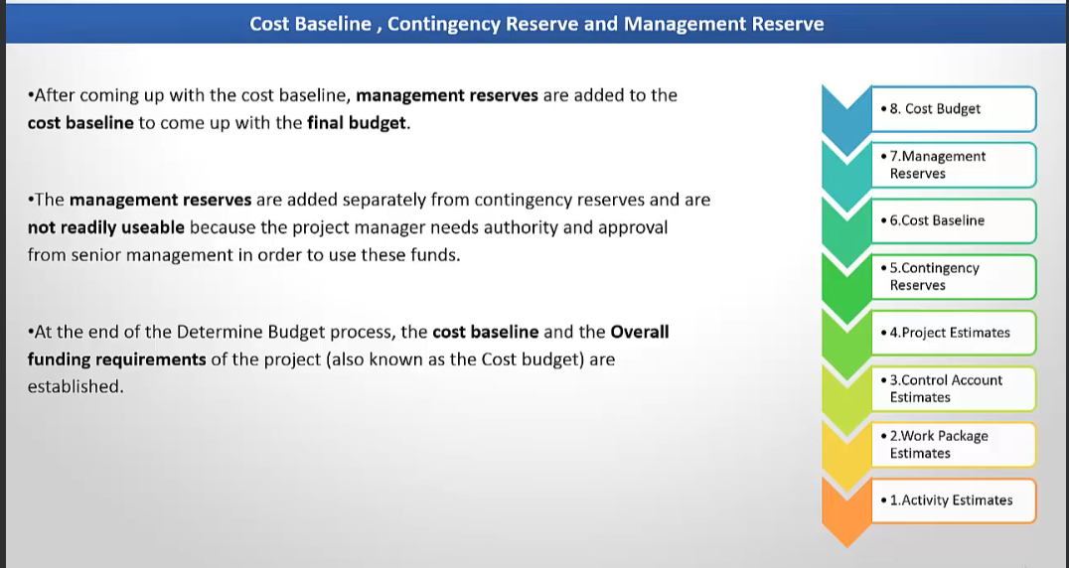

Slide 42
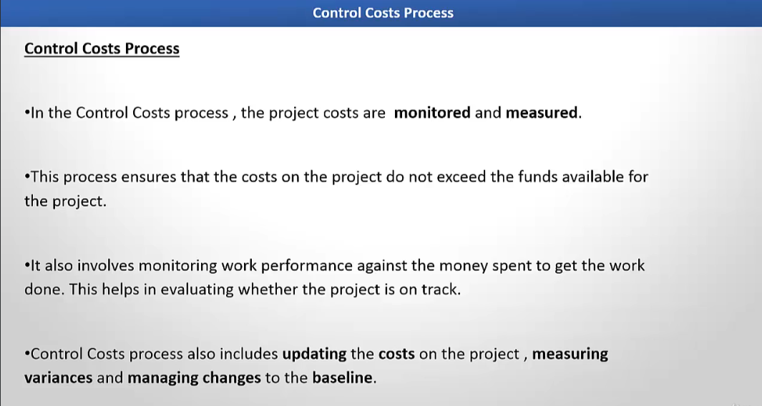

Slide 43
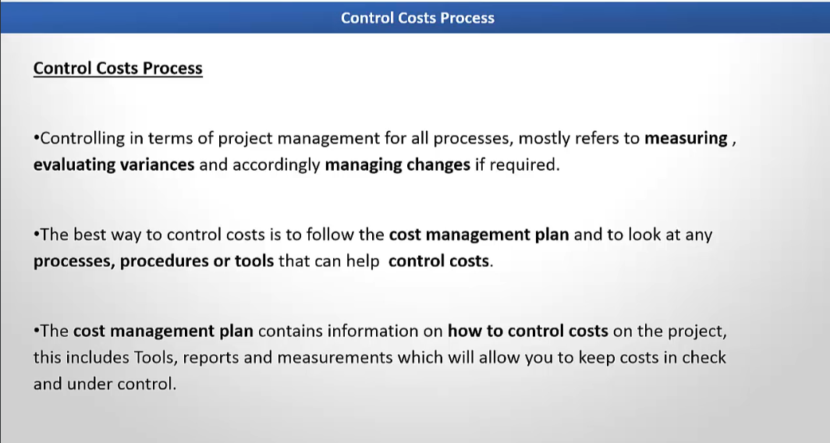

Slide 44
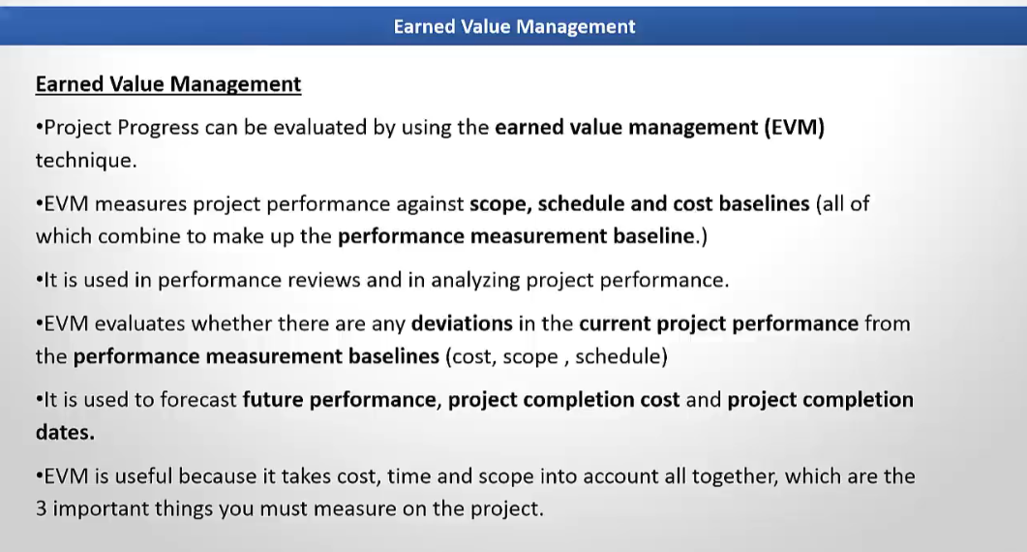

Slide 45
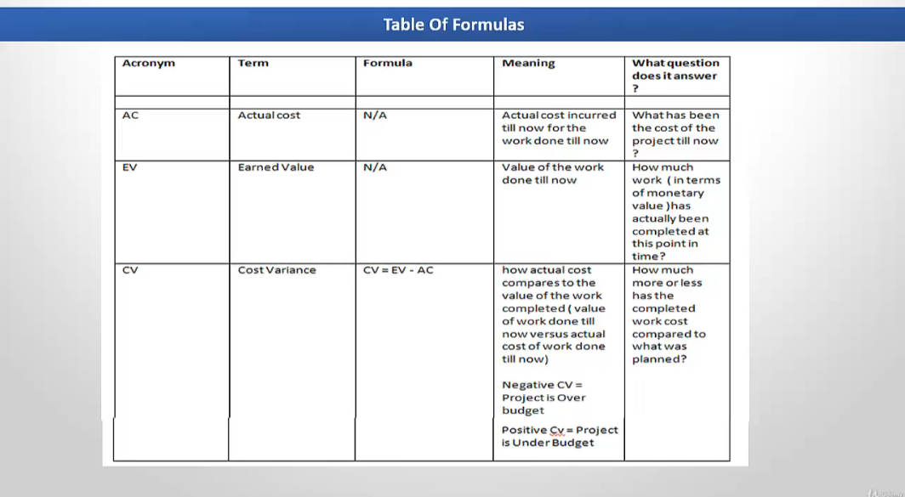

Slide 46
Illustrative Example
Scenario:
You’re building a house:
Total budget: $100,000
Work scheduled to be 50% complete today: PV = $50,000
Work actually completed: 40% (EV = $40,000)
Money spent so far: $45,000 (AC = $45,000)

Slide 47
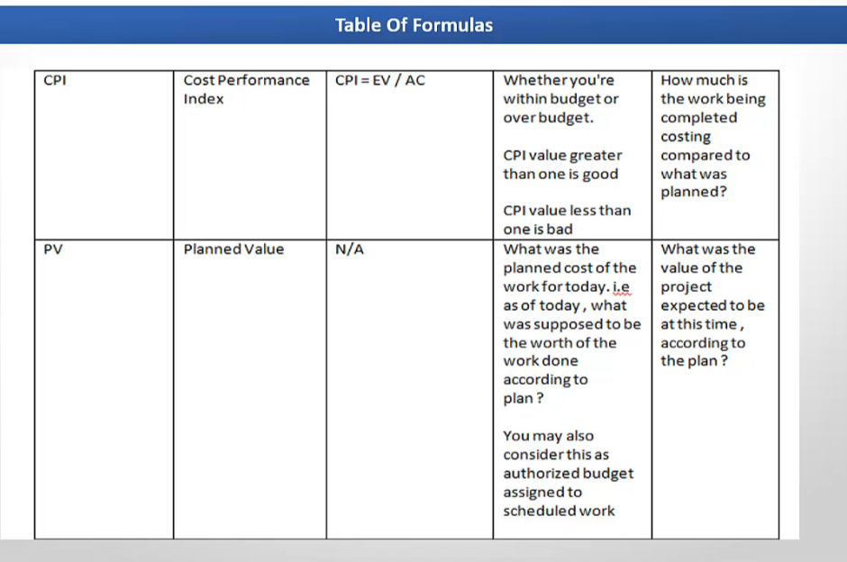

Slide 48
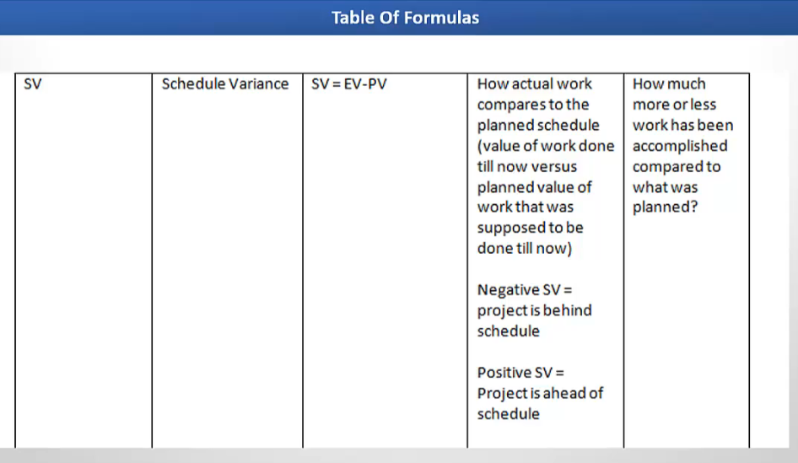

Slide 49
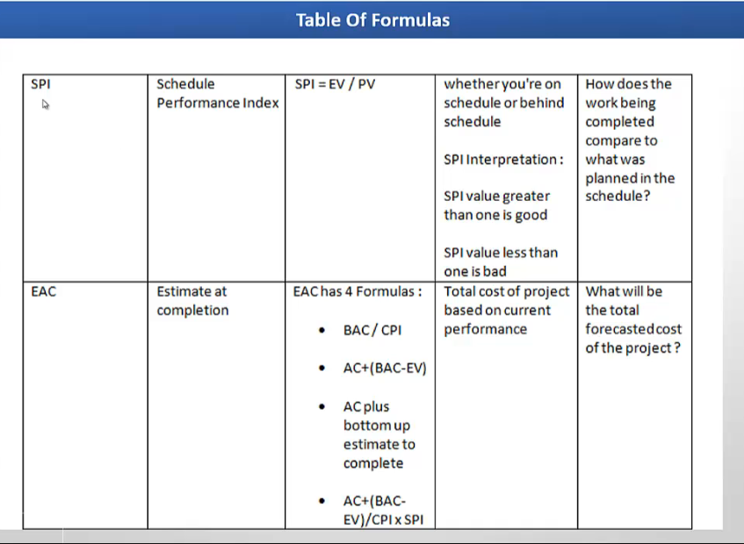

Slide 50
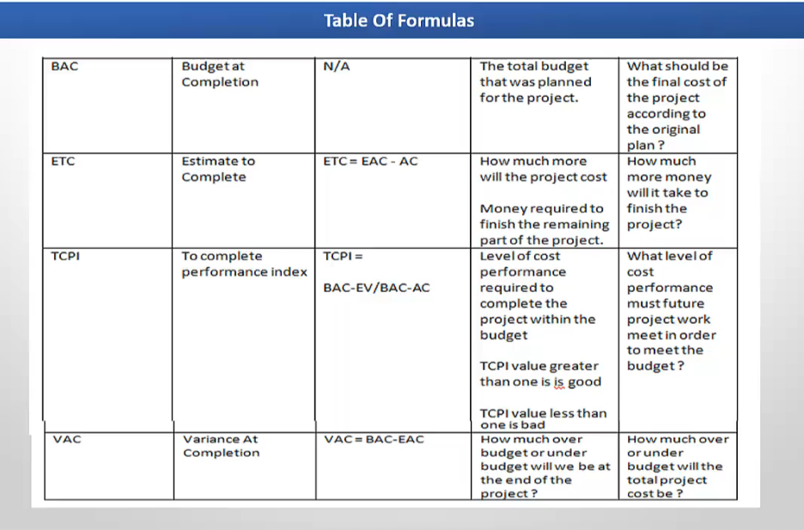

Slide 51
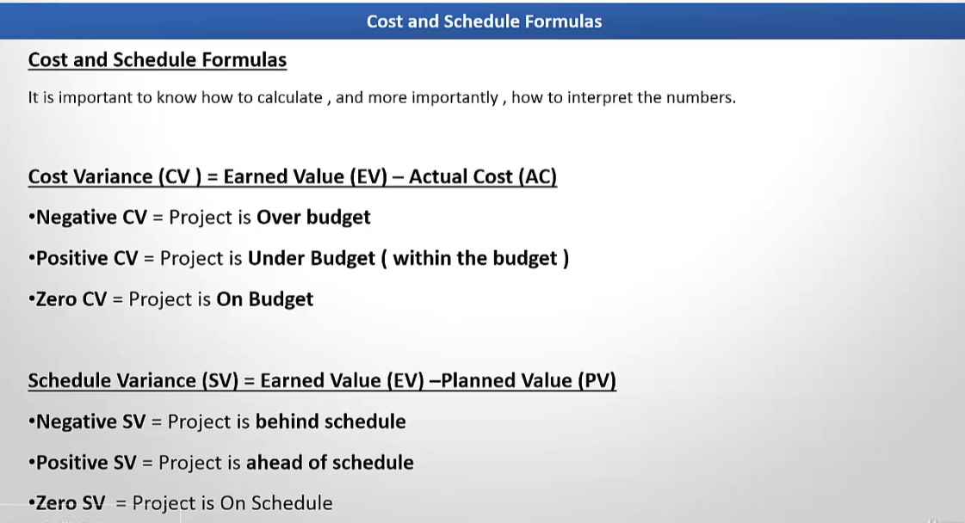

Slide 52
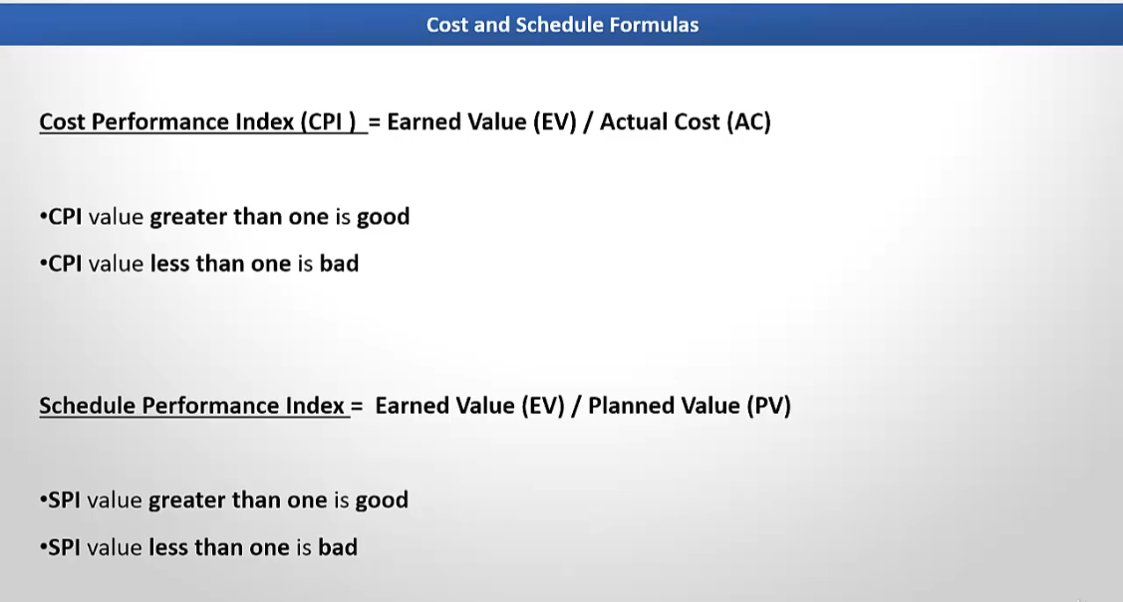

Slide 53
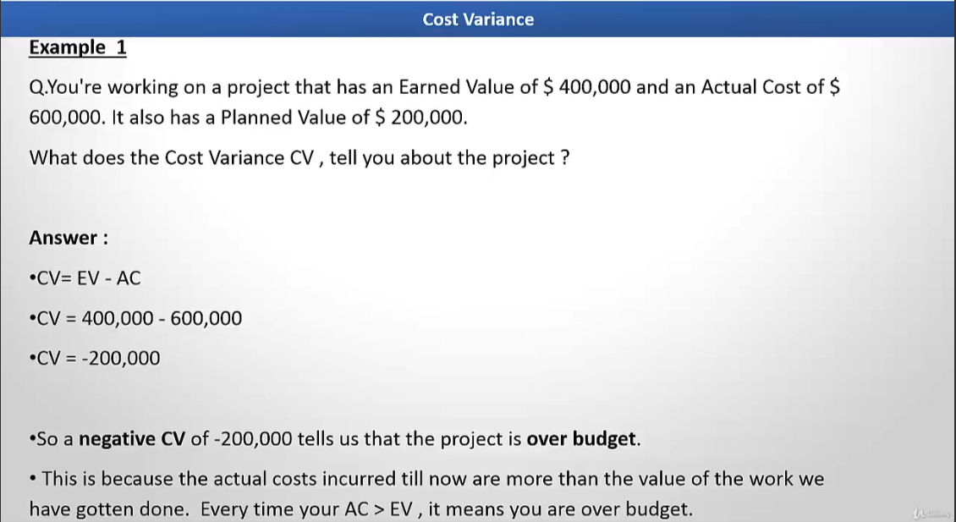

Slide 54
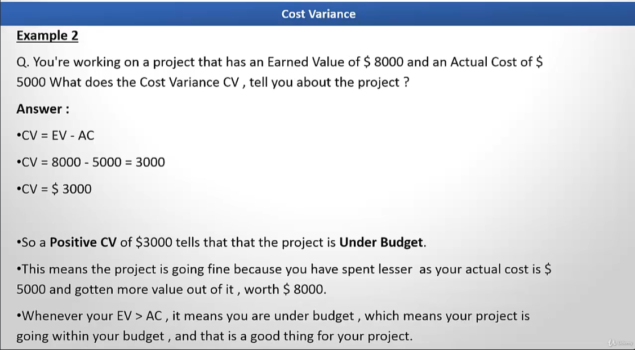

Slide 55
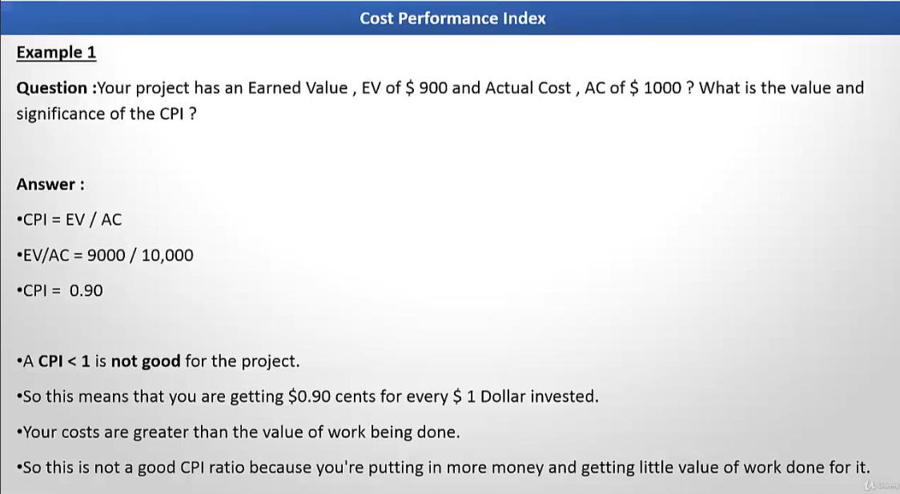

Slide 56
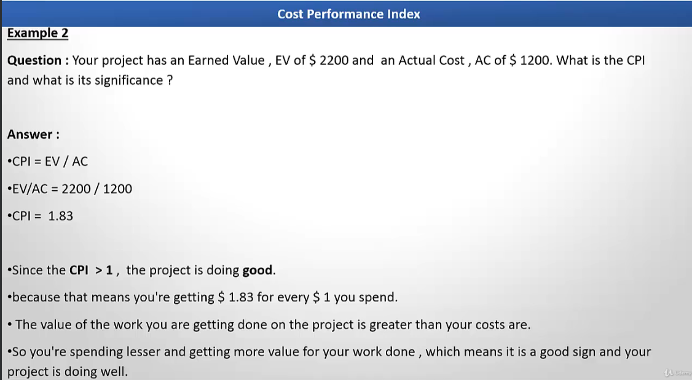

Slide 57
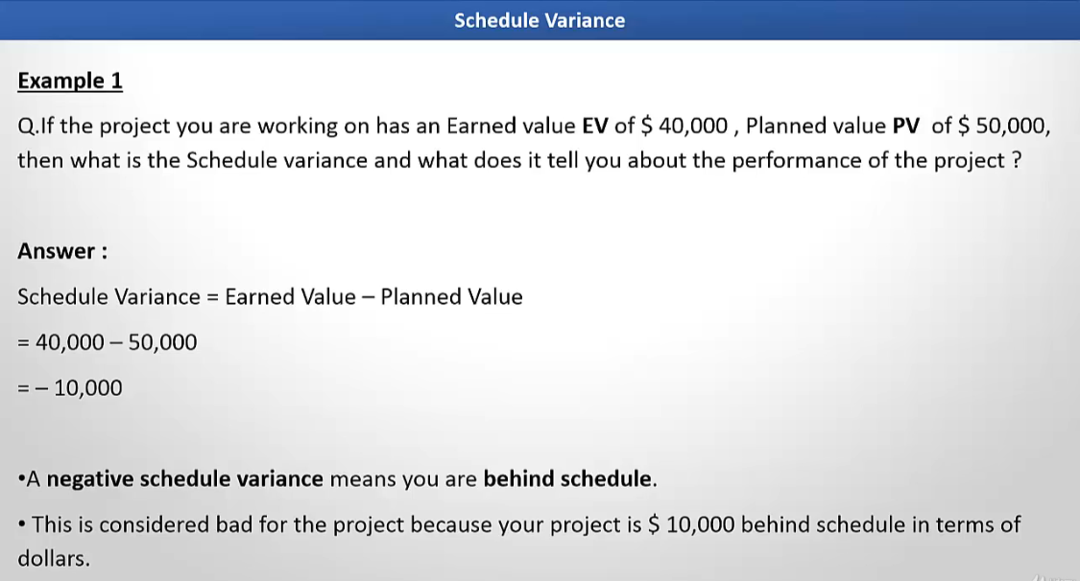

Slide 58
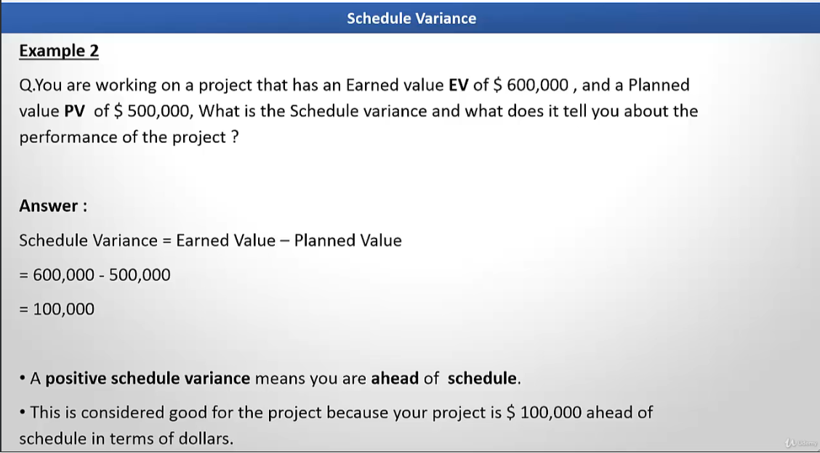

Slide 59
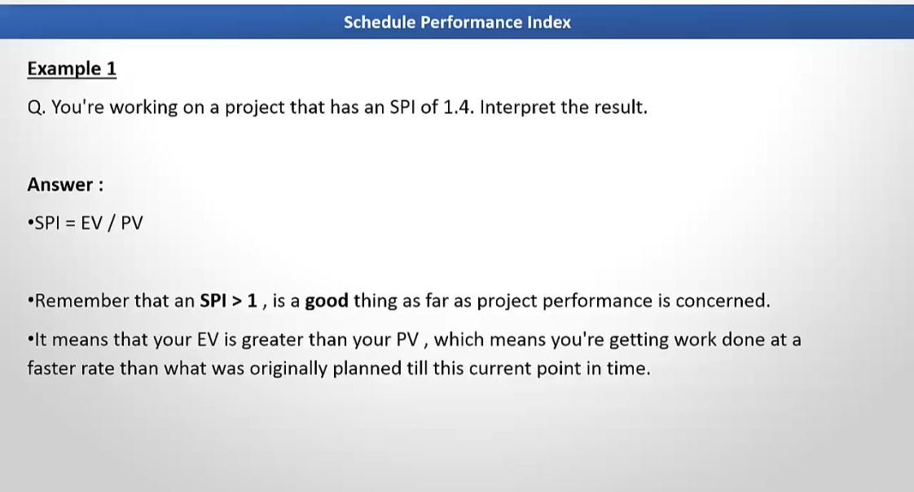

Slide 60
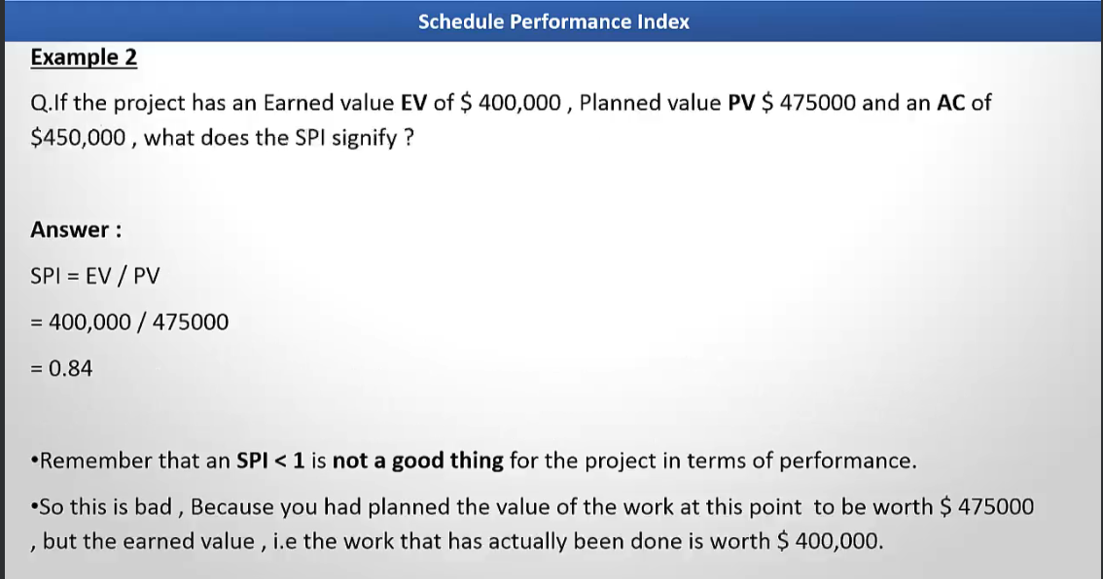

Slide 61
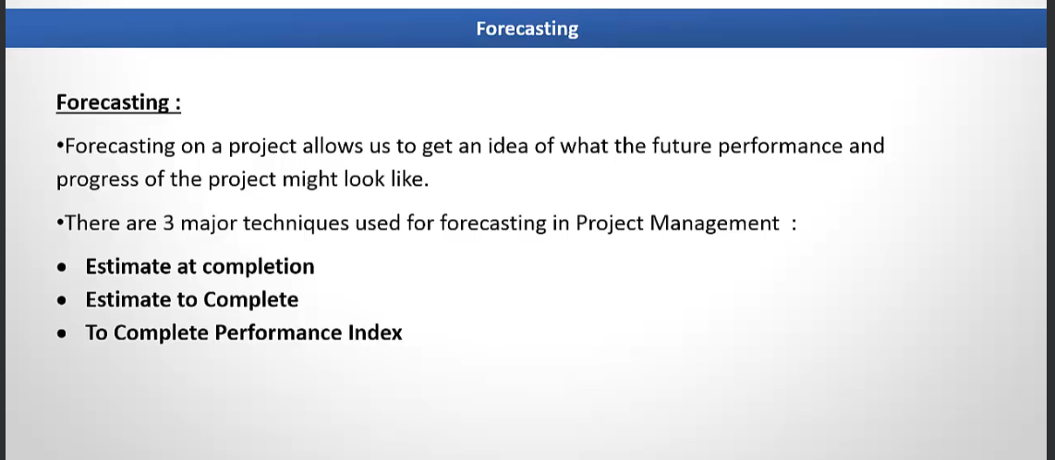

Slide 62


Slide 63


Slide 64


Slide 65


Slide 66


Slide 67


Slide 68


Slide 69


Slide 70


Slide 71


Slide 72


Slide 73


Slide 74


Slide 75


Slide 76


Slide 77


Slide 78


Slide 79


